Slide 1
Siya Health®
We started with patients. Not software.
Physician-led ADHD + primary care telehealth · four states (CA · TX · PA · FL)
1 / 15
Notes:
Company name big, descriptive tagline, no date (OpenVC rule).

Slide 2
Siya Health®
The problem
Patients weren’t failing to find care. Care was failing to follow them.
Visit
→
Plan
→
Pharmacy
→
Follow-up
→
Refill
→
Life
Everyone optimizes the first visit.
Care actually breaks down at Pharmacy · Follow-up · Refill.
2 / 15
Notes:
Specific, undeniable problem for adults in longitudinal care.

Slide 3
Siya Health®
The solution
So we built the missing pieces ourselves.
Physicians → Operators → Systems builders
Multi-state licensure
CA · TX · PA · FL — providers credentialed and compliant in every state we serve.
Offshore clinical operations
Hired, trained, and QA’d from scratch — scheduling, pharmacy coordination, patient follow-up.
Standardized provider workflows
Protocols and SOPs shared across all providers and states — care doesn’t depend on memory.
3 / 15
Notes:
Solution = the operating model, built by doing.

Slide 4
Siya Health®
Product
We deliver care today. We’re encoding the workflow next.
What we deliver today
Carepatron
Spruce
Creyos
Records · booking
Messaging · calls
Cognitive assessment
End-to-end ADHD care — coordinated across these tools today, held together by our own protocols and clinical judgment. This is the running process, not a product claim.
Cognitive assessment (Creyos) is one input into this process — not the product.
What we’re building
Concept — in design, informed by workflows already validated in our practice.
Care Timeline
Provider Workspace
Refill / Follow-up
· Visit · 06/12
· Patient context
· Queue · 12 open
· Plan shared
→
· Protocol checklist
→
· Needs review
· Pharmacy note
· Decision notes
· Pharmacy hold
· Follow-up due
· Next action
· Due this week
· Refill request
· Handoff ready
· Closed · 8
Care Timeline → Provider Workspace → Refill / Follow-up queue. Software encodes the practice.
4 / 15
Notes:
PRODUCT SLIDE — POSITIONING. Section 1 = today’s running care (Carepatron / Spruce / Creyos as tools, held by Siya protocols) — NOT a product claim. Section 2 = the only product visual: low-fi concept wireframe with required label “Concept — in design, informed by workflows already validated in our practice.” No Creyos report screenshot/hero. Full Creyos sample belongs in the data room only.

Slide 5
Siya Health®
Traction
Revenue nearly 3× since February. Cash-flow positive.
Monthly gross revenue — 2026
92
76
2,000+
1,000+
57
Patients treated
ADHD evaluations
44
47
33
30
150+
600+
Recurring members
Reviews · 4.8★
4 states
Cash-flow+
Jan
Feb
Mar
Apr
May
Jun
Jul
CA · TX · PA · FL
Operations
$ thousands / month · gross
$378k+ gross 2026 YTD (Jan–Jul) · founder-confirmed books.
5 / 15
Notes:
Action title with real growth claim (Feb $30k → Jul $92k). No vanity %.

Slide 6
Siya Health®
Where we are, honestly
Our growth engine today is founder-led — and it works.
Proof
Risk
Fix
Founder-led relationships and networking — on top of a full clinical load — fill all providers’ panels, not just the founder’s own.
That is a key-person dependency. We say so plainly.
This round funds clinical capacity and redundancy, so proven acquisition runs without routing every relationship through one person.
Proof + risk + fix — not a disclosure buried in an appendix.
6 / 15
Notes:
Differentiator slide. Keep.

Slide 7
Siya Health®
Business model
Cash-pay, recurring, no insurance risk.
$149
$79 / mo
$149 / mo
Initial evaluation
Ongoing care — non-controlled
Ongoing care — controlled
One-time, self-pay
Recurring membership
Recurring membership
Subscription-style continuity: 150+ recurring members and growing.
Roughly $600 per patient-year in professional fees (bottom-up, competitor-benchmarked).
Cash-pay means no payer contracts, no reimbursement risk, and revenue from day one.
7 / 15
Notes:
ARPU + model + why-this-model, per OpenVC. $149/$79/$149 canonical pricing.

Slide 8
Siya Health®
Market — bottom-up
15.5M diagnosed adults. $2.9B serviceable today.
Layer
Definition
Size
TAM
U.S. adult ADHD clinical services (professional fees)
~$10B
SAM
Adult ADHD virtual care (telehealth-willing, cash-pay comps)
~$2.9B
SOM
Year-3, capacity-derived (~40 clinician FTEs)
~$16M
Built bottom-up: 15.5M diagnosed U.S. adults (CDC) · ~half already use telehealth for ADHD · ~$600/patient-year professional fees.
No inflated blended TAM. Full sizing workbook available in diligence.
8 / 15
Notes:
Bottom-up per ADHD-MARKET-SIZING-2026.md. Never cite $19B/$122B societal-burden numbers.

Slide 9
Siya Health®
Competition
Different job. Not a feature checklist.
Episodic telehealth
Optimizes first-visit volume, not continuity
Generic EHR tools
Records history, doesn't guide next action
Point cognitive tools
One-time score, not ongoing care
Traditional psychiatry
Access-limited, waitlist-bound
Siya
Continuity, evaluation through refill — 2,000+ patients
No feature matrix. No “everyone top-right” quadrant. The difference is the job we do.
9 / 15
Notes:
OpenVC Competition — categories only. One explicit difference sentence per row. Language locks: practice/workflow/protocol — no OS/platform/SiyaOS.

Slide 10
Siya Health®
Go-to-market
A process — not a channel wishlist.
01 · Today
Primary engine
Founder-led relationships and networking fill all providers’ panels — not just the founder’s.
02 · Live test
Texas Search
Paid Search test live in Texas — [confirm conversion count from Google Ads before upload]
03 · Transition
This round’s job
Add clinical capacity, then move from founder-led fill to systematic acquisition — reproduce Search TX → CA.
04 · Measurement
No guessing
Full CAC and payback period confirmed by August 30, 2026.
10 / 15
Notes:
OpenVC GTM — process not channels. TX conversions from Google Ads only (TX_SEARCH_CONVERSIONS=None). CAC by August 30, 2026 — do not invent.

Slide 11
Siya Health®
Why now
The playbook is proven. The environment rewards how we practice.
Texas
Search conversions proven — a repeatable acquisition playbook exists
California
Revenue growing — next market for the same playbook
Regulation
Environment rewards protocolized, auditable care over low-touch mills
Discipline
SOPs, QA, and multi-state compliance already in place
11 / 15
Notes:
Hook/why-now. No AI hype.

Slide 12
Siya Health®
Use of funds
We’re raising $500k to scale a working practice.
01
Clinical capacity & redundancy
More providers and coverage — directly reduces founder key-person risk.
02
Scale proven acquisition
Texas Search converts today. Reproduce the same playbook in California.
03
Working capital buffer
Operate from strength, not desperation.
Objective: 18–24 months of runway to prove the playbook in a second state and remove key-person dependency.
12 / 15
Notes:
Round size + objective + use of proceeds (OpenVC funding-slide spec).

Slide 13
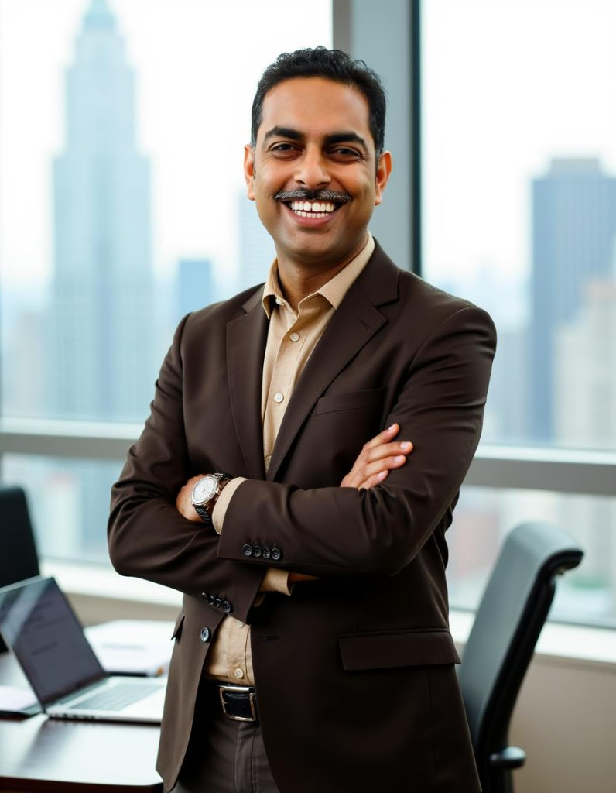

Siya Health®
Founders
Physicians who built the practice before asking for capital.
Dr. Sneh Pandey
Dr. Swati Pandey
Founder · CEO
Co-founder
· Board-certified physician
· Tens of thousands of patient encounters — primary care, obesity, hospital medicine, ICU
· Built multi-state practice to 2,000+ patients, cash-flow positive, bootstrapped
· Board-certified physician
· Co-built clinical protocols and provider workflows across four states
· Leads clinical quality and patient-experience standards
13 / 15
Notes:
Names, roles, photos, specific achievements — OpenVC team-slide spec. Confirm bullet accuracy with founders.

Slide 14
Siya Health®
Years spent learning how to deliver better care. This round scales what already works.
Seed round
$500,000
Clinical capacity & redundancy · Proven acquisition, next state · Working capital
14 / 15
Notes:
Ask stated plainly.

Slide 15
Siya Health®
Let’s talk.
Dr. Sneh Pandey · Founder & CEO
chiefservant@siya.health
siya.health
15 / 15
Notes:
OpenVC rule: CEO's direct email — not care@/info@. Set CEO_EMAIL in the builder.

